Slide 1
Exploratory Data Analysis
Customer Segmentation and Profiling Analysis
Guided by:
Dr. Chris Asakiewicz
Group – 7
Revanth Vemula
Harshil Chauhan
Raghava Sagar

Slide 2
Data and Code
The dataset originally found on Kaggle, provided to the owner by Dr. Omar Romero-Hernandez.
29 Columns with attributes divided into categories like People, Product, Promotion, Place.
2240 rows of data where each row gives information about one customer.
Exploratory data Analysis was done on python using Jupyter notebook.
References:
Data: https://www.kaggle.com/datasets/imakash3011/customer-personality-analysis
Code: https://drive.google.com/file/d/1hazUT88cYNqMfzgwhspHaaSLh3ezlgqQ/view?usp=sharing

Slide 3
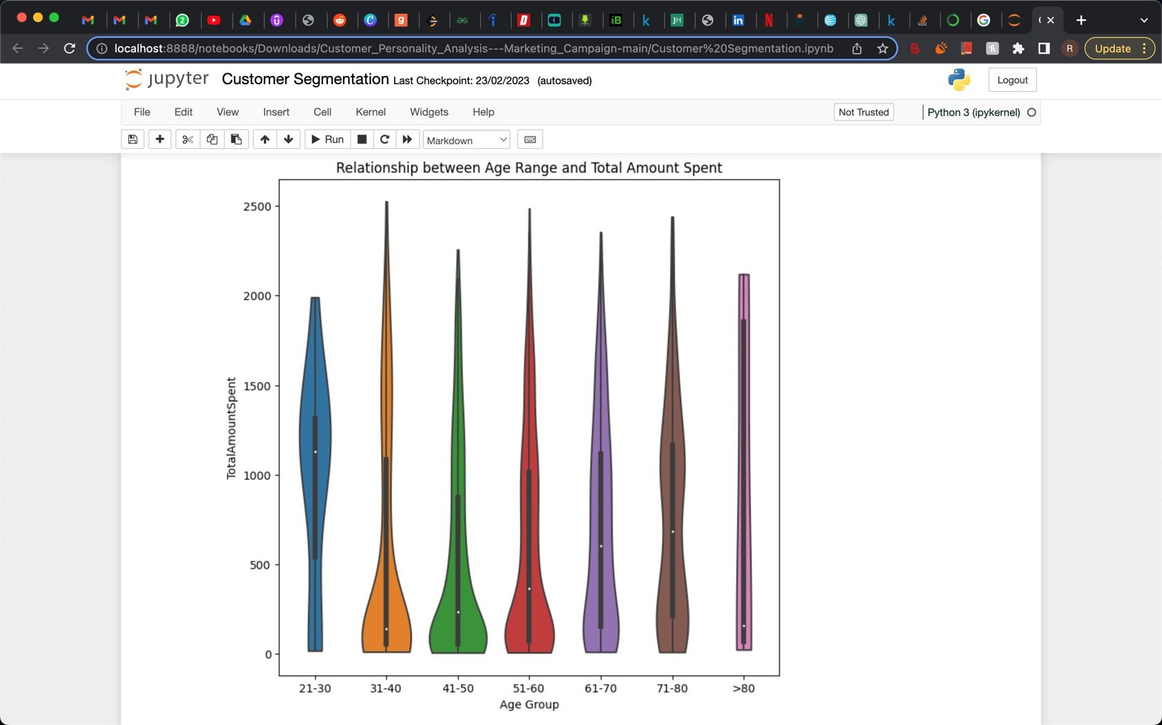
Bivariate Analysis
Age Vs Total Amount Spent
Customers are segmented by age into 7 groups.
More expenditure is done by 21- 30 age group averaging $1127.
Outliers are seen in all age ranges. With >80 having the most.

Slide 4
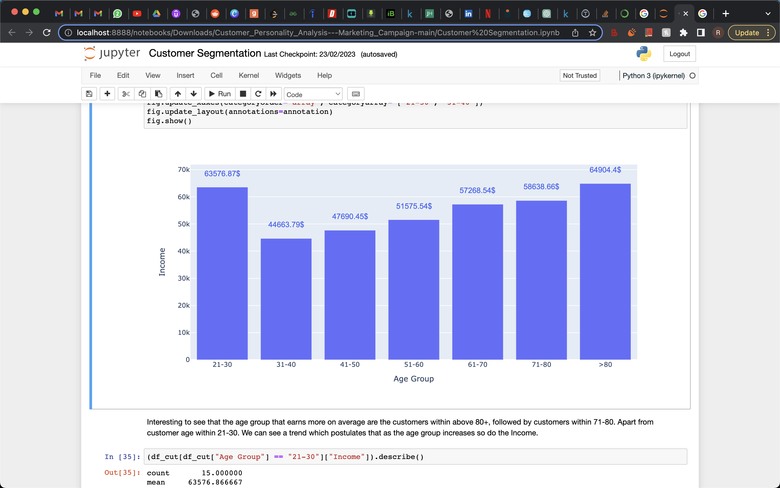
Age Vs Income
>80 customers earn the highest income, followed by 21-30 group.
Income alone may not be a reliable predictor of how much someone will spend.

Slide 5
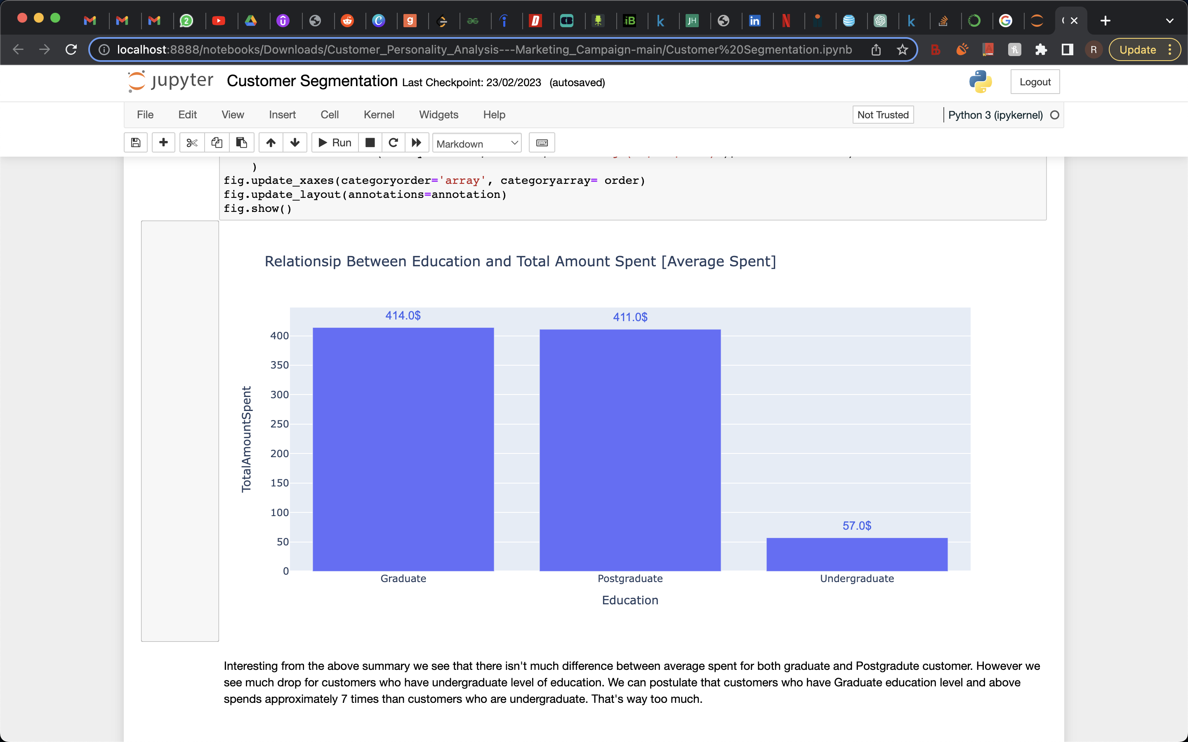
Education VS Total Amount Spent
Spending by Graduates and Postgraduates are almost equal in amount.
Average spent by undergrads is almost 7 times lesser when compared to others.

Slide 6
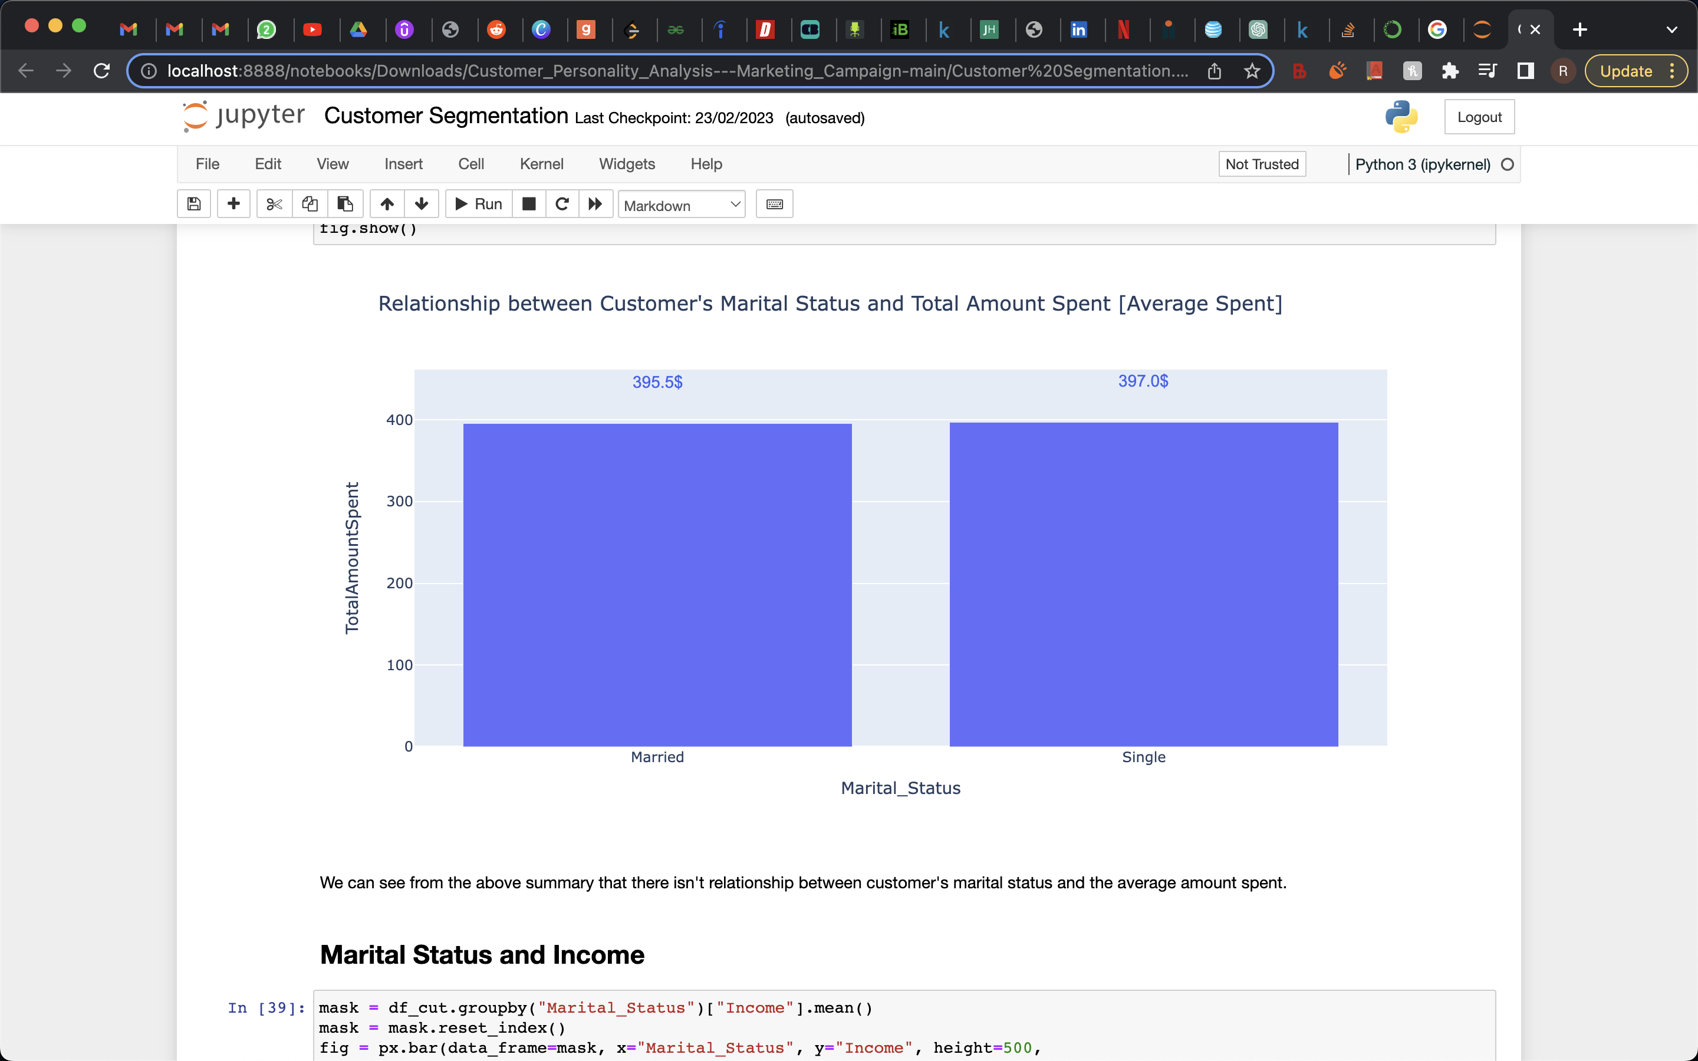
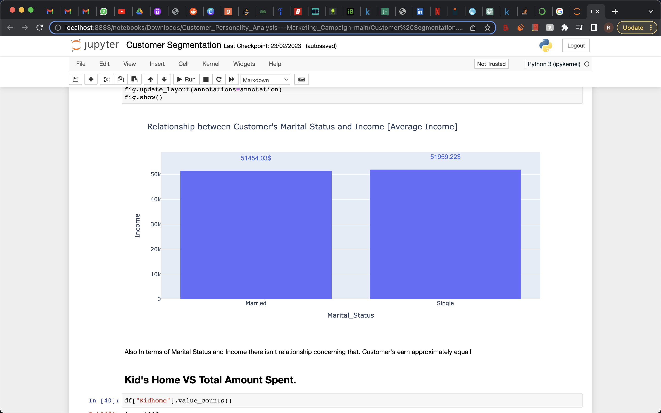
Marital Status and Total Amount
Marital Status and Total Income
The above diagrams makes clear that there is no connection between a customer's marital status and the typical amount paid. ​Also, There is no association between marital status and income in that regard.

Slide 7
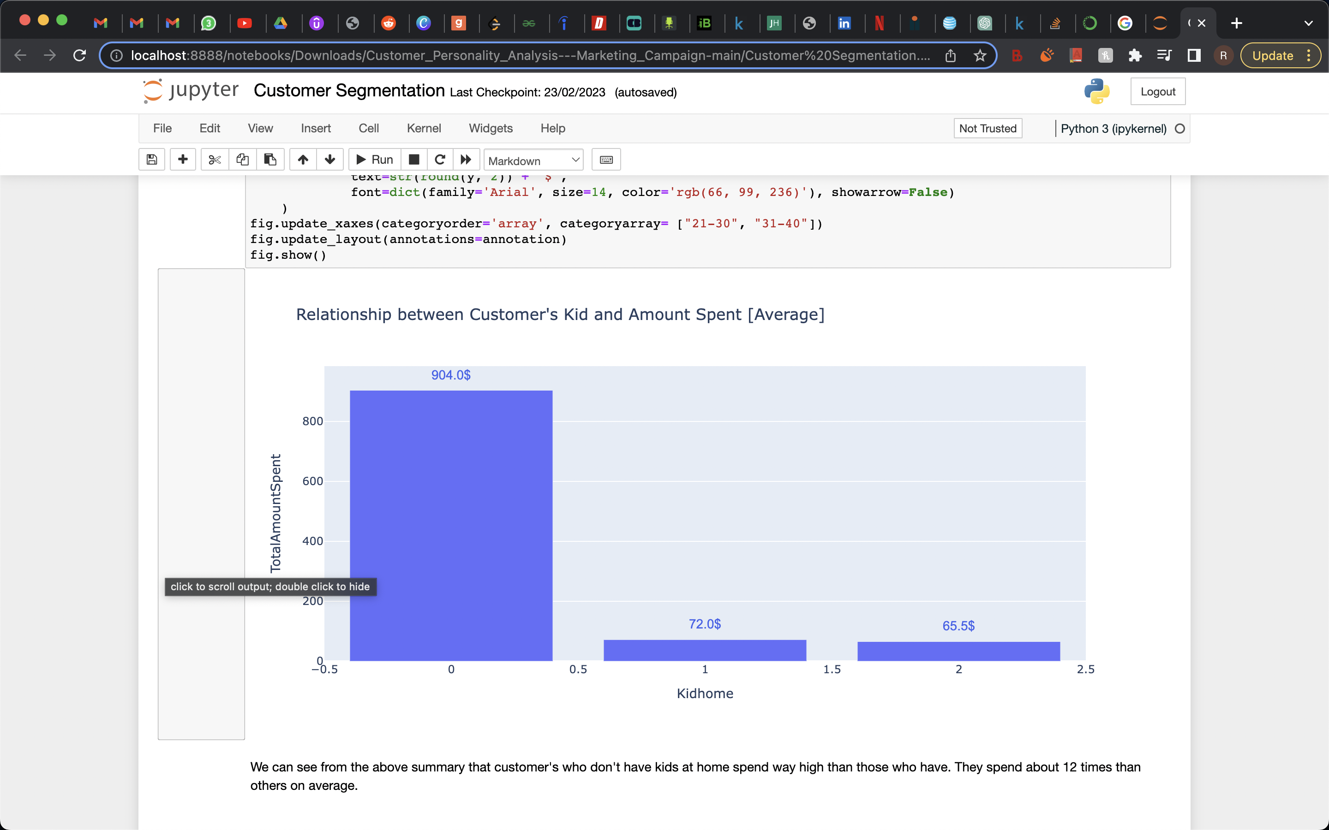
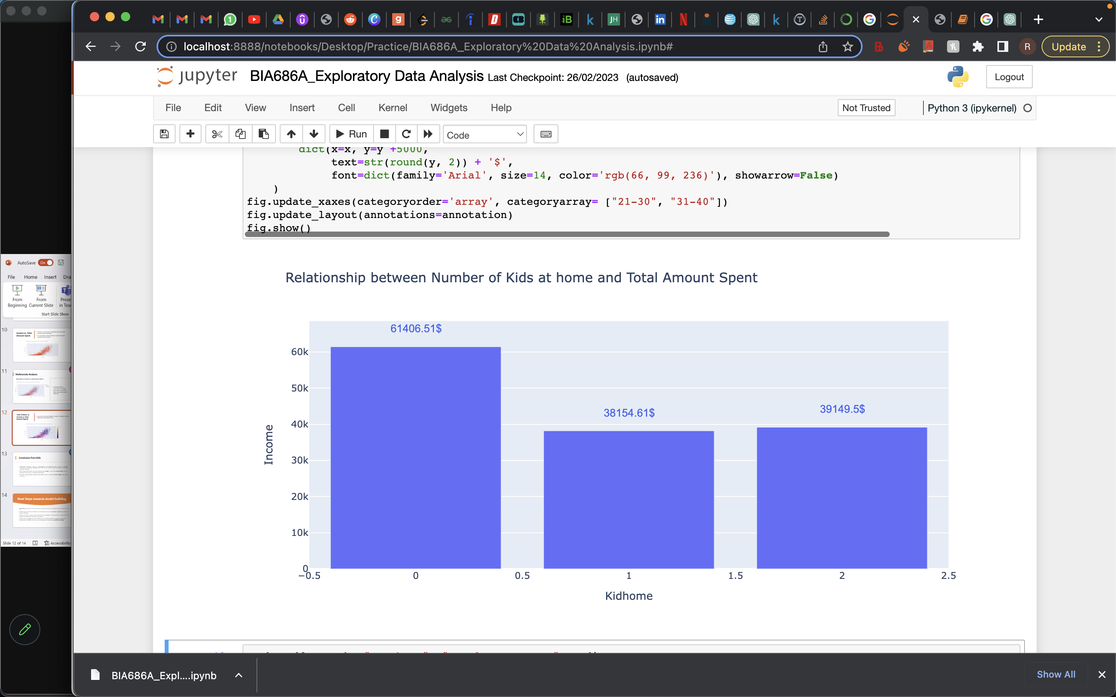
Kid's Home VS Total Amount Spent
Kid's Home VS Income
The diagram above shows that customers who don't have children at home earn and spend far more than those who do. On average, they spend around 12 times more than other people.

Slide 8
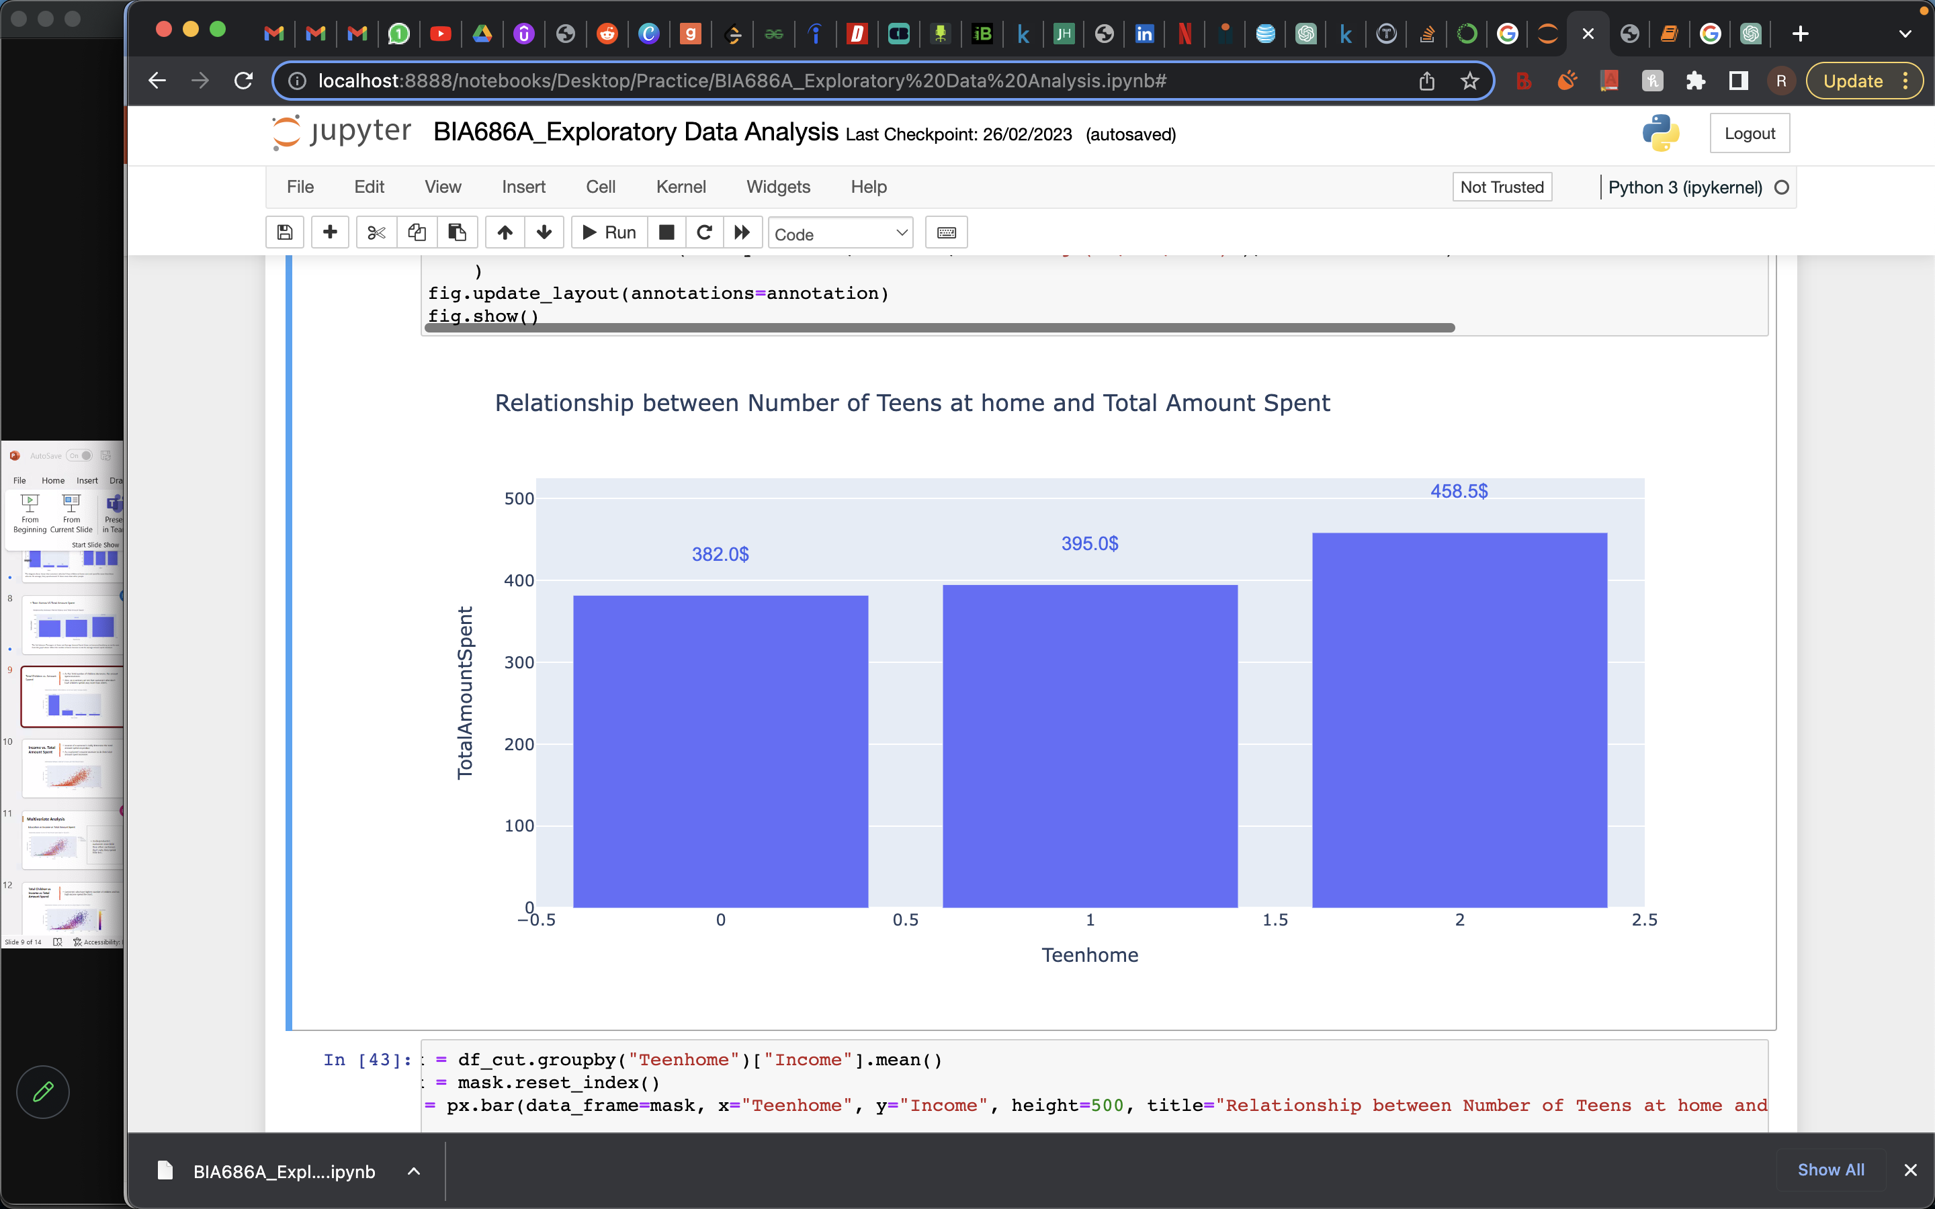
Teen Homes VS Total Amount Spent
The link between Teenagers at Home and Average Amount Spent shows an increased tendency, as can be seen from the graph above. When the number of teens increase so do the average amount spent increases.

Slide 9
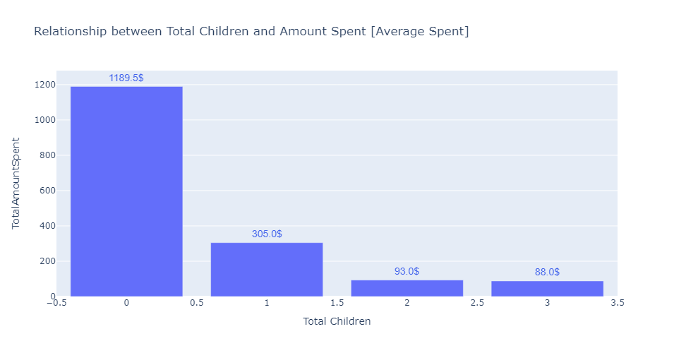
Total Children vs. Amount Spend
As the Total number of Children decreases, the amount Spent increases.
Also, on a contrary we see that customers who don't have children spends way more than others.

Slide 10
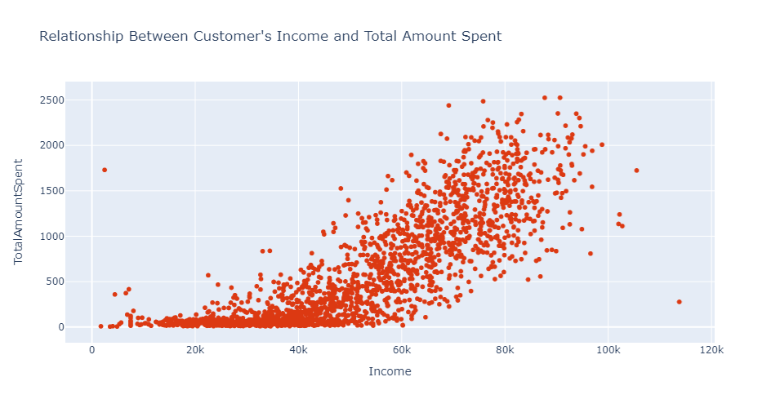
Income vs. Total Amount Spent
Income of a customer's really determine the total amount spend on product
As a customer's income increase so do their total amount spent increases

Slide 11
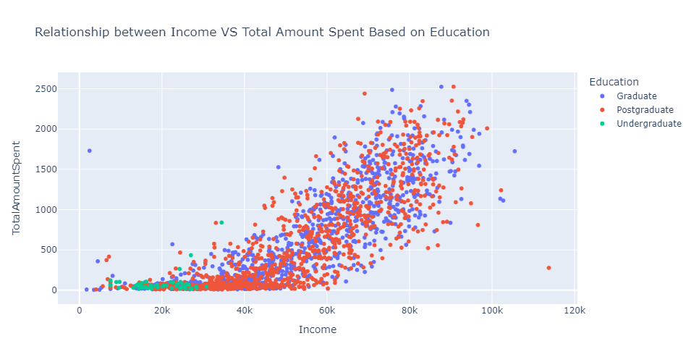
Multivariate Analysis
Education vs Income vs Total Amount Spent
Undergraduate's customers earn little than other customers that's why they spend little less.

Slide 12
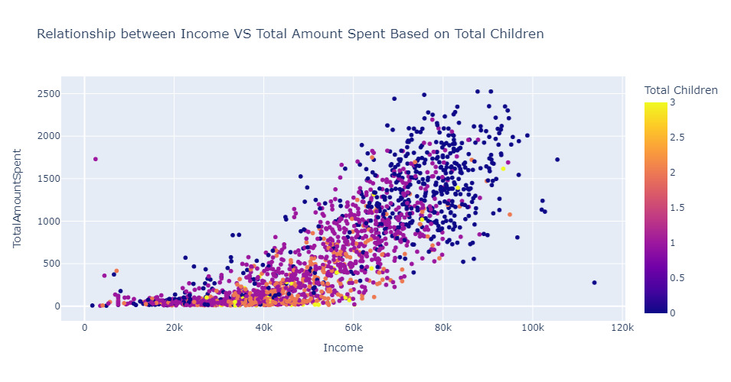
Total Children vs Income vs Total Amount Spend
Customers who have highest number of children and has high income spend the most.

Slide 13
Conclusion from EDA
Segmented customers based on demographic and behavioral data, helps in enabling personalized marketing campaigns that cater to the specific needs and interests of each customer segment.
By far from observation, we may conclude that Income is one of the key indicator used to determine the amount a customer would spend.
Customers with graduate education and above tends to spend 12 times higher than other customers.
Notes:
For point 2, The reason for this is because customers with graduate education level or above earns above 2 times than customers with undergraduate education level.

Slide 14
Next Steps towards model building
Clustering of products based on key features like age, income, spending amount, promotion used, etc.
Identify popular product combinations and preferences for each customer segment to optimize product offerings.
Analyze customer responses to past promotional campaigns to understand their preferences and design more effective promotions in the future.
Study customer engagement across different sales channels (website, catalog, and stores) to help develop strategies to increase sales through each channel using customer profiling.

